Slide 1


Impact of leveraging HPC in Image Processing
DA-212 MLOps – Course Project
Team Members
Om Prakash Animesh Kumar
Sangeethkumar I Parthasarathy Ramesh
Ankitha M

Slide 2
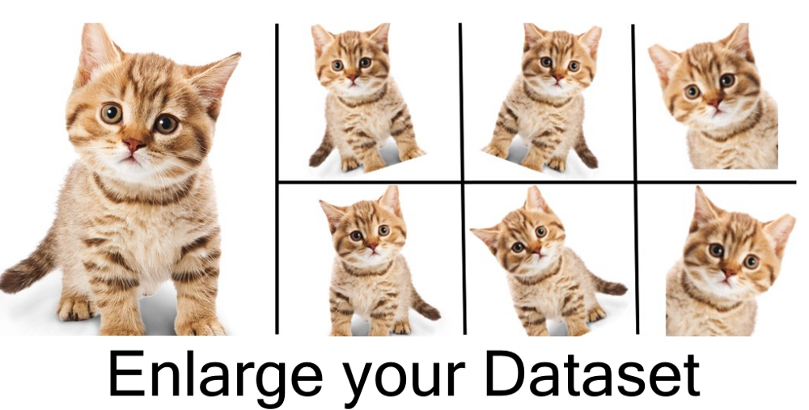
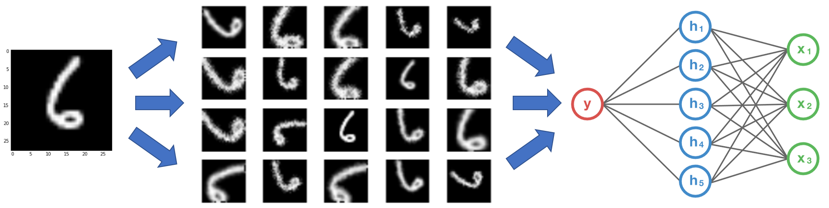
Problem Background
Deep CNN have performed remarkably good on many Computer Vision (Image dataset) tasks.
It requires big amount of data (to learn fine tuned parameters).
Image augmentation is a technique that is used to artificially expand the data-set.
Image Augmentation consists of techniques that rotates/flips/zoom etc. the datasets.
[Source] https://www.kdnuggets.com/2018/05/data-augmentation-deep-learning-limited-data.html
[Source] https://www.snorkel.org/blog/tanda

Slide 3
Problem Statement and Proposed Solution
Image processing incurs a lot of overhead in sequential algorithm.
To achieve better performance, we first identify and segregate sequential and Parallel task and execute them over scale and to exhibits high degree of parallelism when run over technological advanced multi-core multi threaded GPU based platform.
High Performance Computing(HPC) address increasing demand for analyzing/processing huge amount of data in less time.
Here we will parallelize different image augmentation techniques by leveraging HPC based implementation to bring down the execution time.
Image Rotation
Image Flip
This project focusses on comparison between a normal implementation v/s HPC based implementation.(OpenMP and CUDA based HPC implementation)

Slide 4
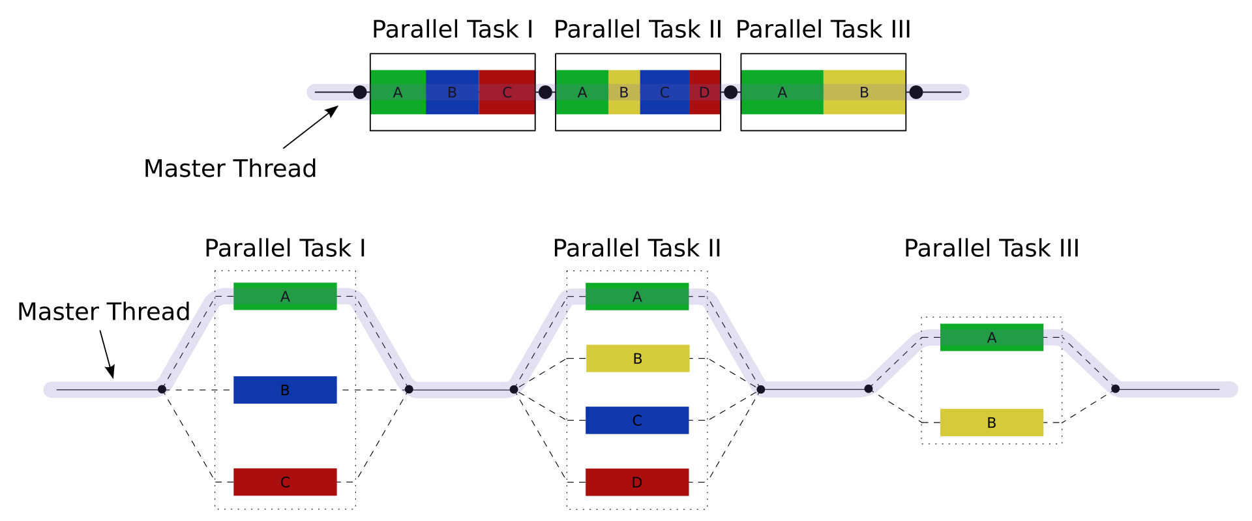
OpenMP
Multithreading implementation.
Master thread executes sequential sections
Master thread forks slave threads
Parallel sections of the code is divided among these slave threads which execute them concurrently
#pragma omp directive indicates parallel block of code
Source : https://en.wikipedia.org/wiki/OpenMP

Slide 5
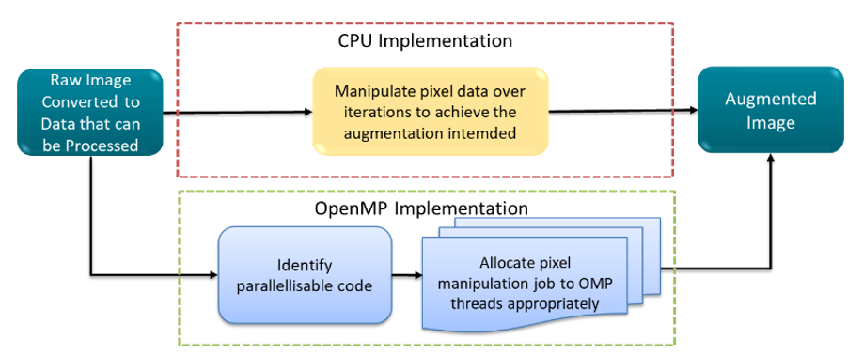
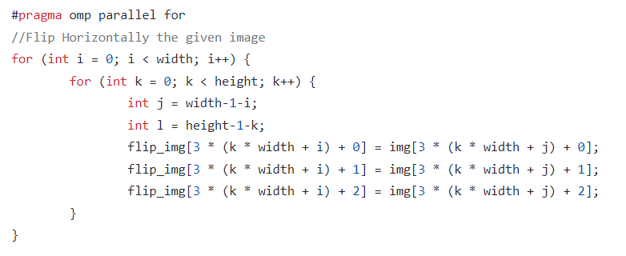
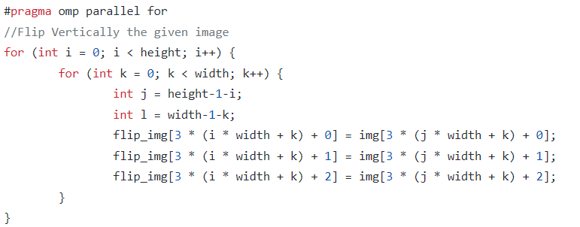
OpenMP Implementation
Vertical and horizontal flipping of images
Task of modifying pixel value is shared among different threads

Slide 6
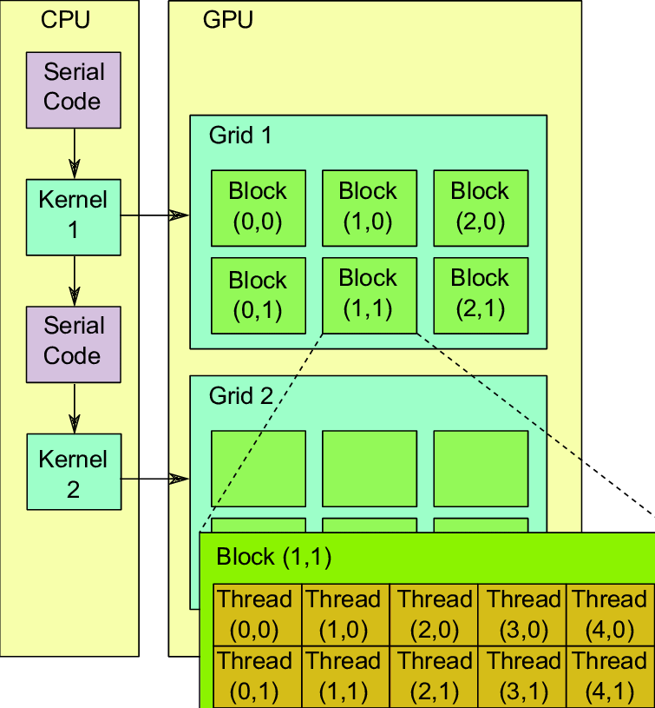
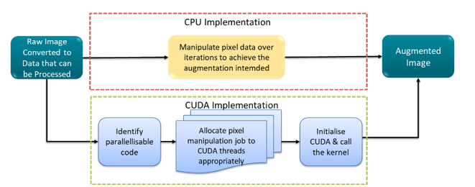
CUDA
Parallel programming which leverages the power of GPU
GPUs have lower clock speed, but since they have huge number of cores, they can efficiently perform parallel processing
Threads are arranged in n dimensions within n dimensional blocks arranged as grids. These are executed by Streaming Processors
Source : https://www.researchgate.net/figure/Schematic-illustration-of-GPU-architecture-and-programming-elements_fig4_274838864

Slide 7
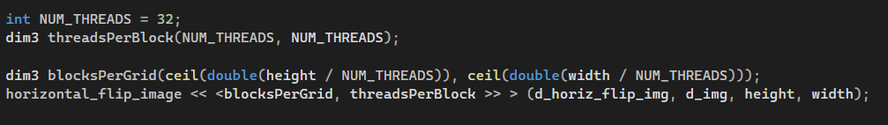
CUDA Implementation
Horizontal, vertical flipping, rotation and scaling up/down of images
Kernel call with 2D grid of blocks .
32x32 threads in each block. Each block handles height/32*width/32 pixels

Slide 8
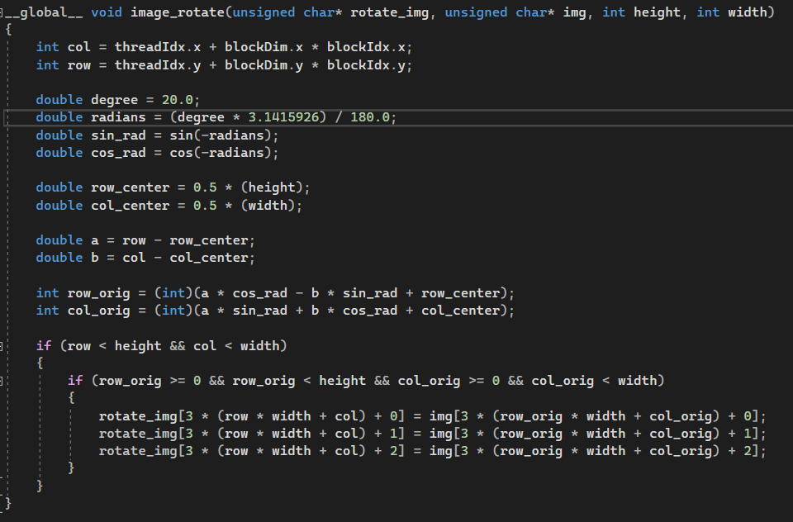
Rotate images

Slide 9
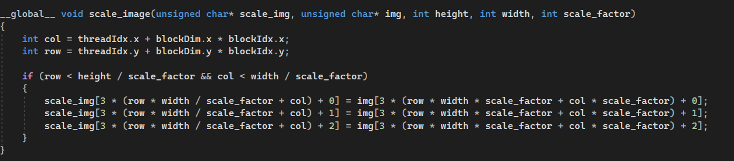
Scaling images

Slide 10
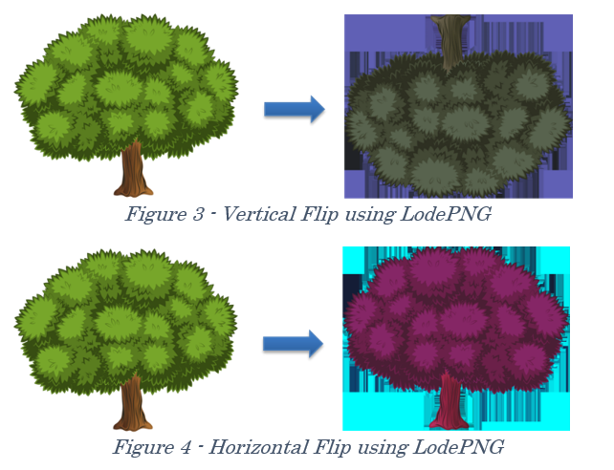
Experiments for loading and saving data
CV::Mat
Challenges : Processing Mat datatype, saving image into GPU, insufficient documentation on GPU Mat. Hence dropped
LoadPng:
Can encode an image into a vector of characters that contain the RBGAlpha information, as well as decode it back into a PNG image
Tried 1D blocks for vertical flip and 2D blocks for horizontal flip
Drawback: Only for PNG images. Encoding is abstracted, so pixel manipulation meddles with contrast/RGB settings of the image
STB is finally used for CUDA based HPC implementation of image augmentation (Vertical Flip, Horizontal Flip, Rotate, Scaling).

Slide 11
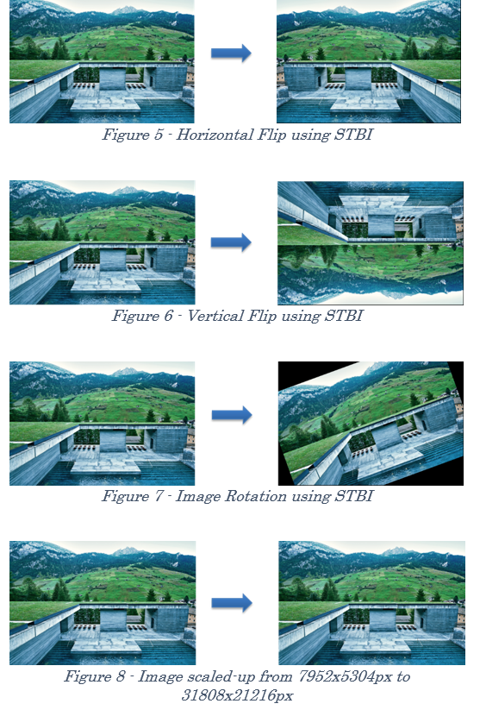
STB Image libraries
Offers an in-built function stbi_load
Also gives the flexibility to load up to 3 channels for a 4-channel image
stibi_image_write functions can be used to save back the image in the disk
More flexible than LoadPNG as it can handle both JPG, PNG etc.
Processing and writing back the processed image is also easier

Slide 12
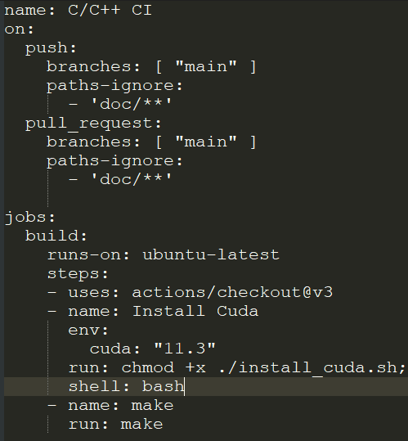
Project CI using GitHub Actions
For our project Continuous Integration, seamless handling and parallel working we created GitHub project repository[1] and used GitHub Actions for our project's Continuous Integration (CI).
Single workflow with one job is used, job: “build” involve multiple steps to install CUDA Setup, run build for CUDA and OpenMP.
To build and test our code in parallel and merge it via pull/push to the project repository.
[1] https://github.com/prakash90om/MLOps_HPC_Image_Processing
Project Schema file: github/workflows/cmake.yml

Slide 13
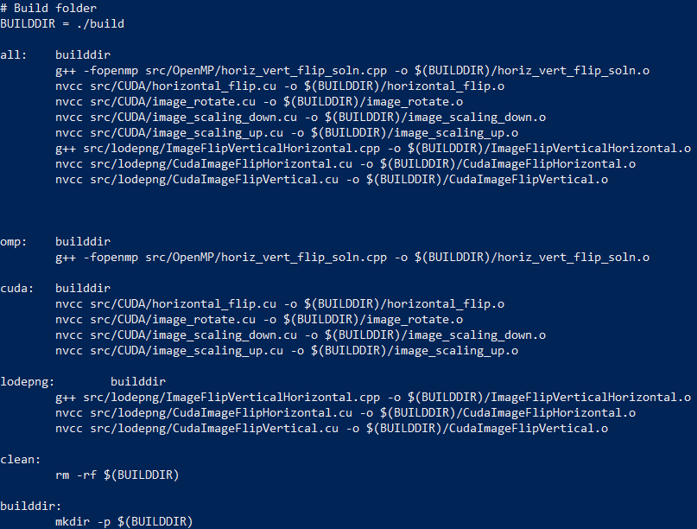
Makefile
Makefile help to decide which parts of a large code base/Project need to be compile/re-compiled or exclude from compilation.
Makefile is prepared based on standard rules and design, and we can write rules as per our requirement.
Makefile really make Continous Integration(CI) process seamless experience. So we are using Makefile[1] for our project CI
[1] https://github.com/prakash90om/MLOps_HPC_Image_Processing/blob/main/Makefile

Slide 14
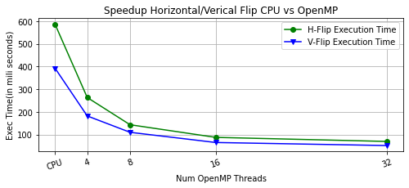
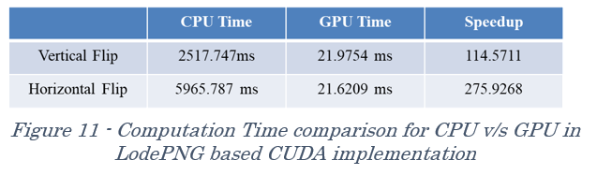
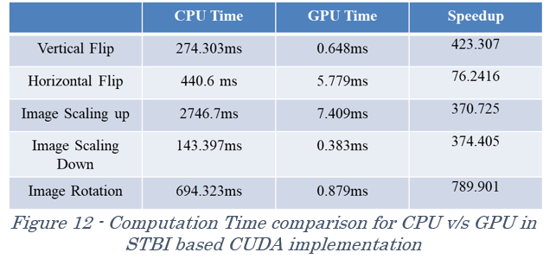
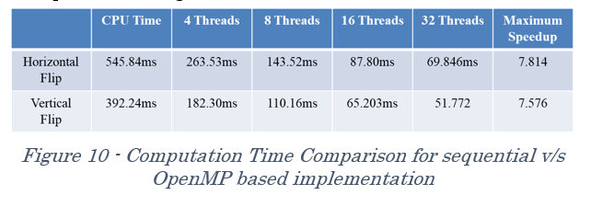
Results

Slide 15
References
LodePNG Documentation: https://lodev.org/lodepng
OpenMP Documentation: https://www.openmp.org/spec-html/5.0/openmp.html
GitHub Actions: https://docs.github.com/en/actions
CUDA: https://docs.nvidia.com/cuda/cuda-c-programming-guide/index.html
Project GitHub Repo: https://github.com/prakash90om/MLOps_HPC_Image_Processing
STB Image: https://github.com/nothings/stb

Slide 16
Thank You!!!

